Slide 1
Day 4 : Shell Scripting Basics
Aleeta Davis
166743
Trainer: Venkat
Devops Engineer Training

Slide 2
Relational Operators
$a -eq $b : to check if values are equal or not.
$a -ne $b : to check if values are not equal.
$a -gt $b : to check if values are greater or equal to.
$a -lt $b : to check if $a is less than $b .
$a -ge $b : to check if values are greater than or equal.
$a -le $b : to check if values are $a is less than $b.
Boolean Operators:
! :logical negation.Inverts true to false and viceversa.
-o : Logical OR . Either one conditions should be true.
-a :Logical AND. Both conditions should be true.

Slide 3
-z $a : if it is zero length then true.
-n $a : if it is non zero length then true.
str : if empty , returns false.
FILE TEST OPERATORS:
-f $name : checks if it is a file or not.
-d $name: checks if it is a directory or not.
-g $name: checks if file/directory has sgid or not
Redirection:
date > file1 : redirects output / content of date to file1.
date >> file1 :appends output / content of date to file1.
wc -l < user : input redirection

Slide 4
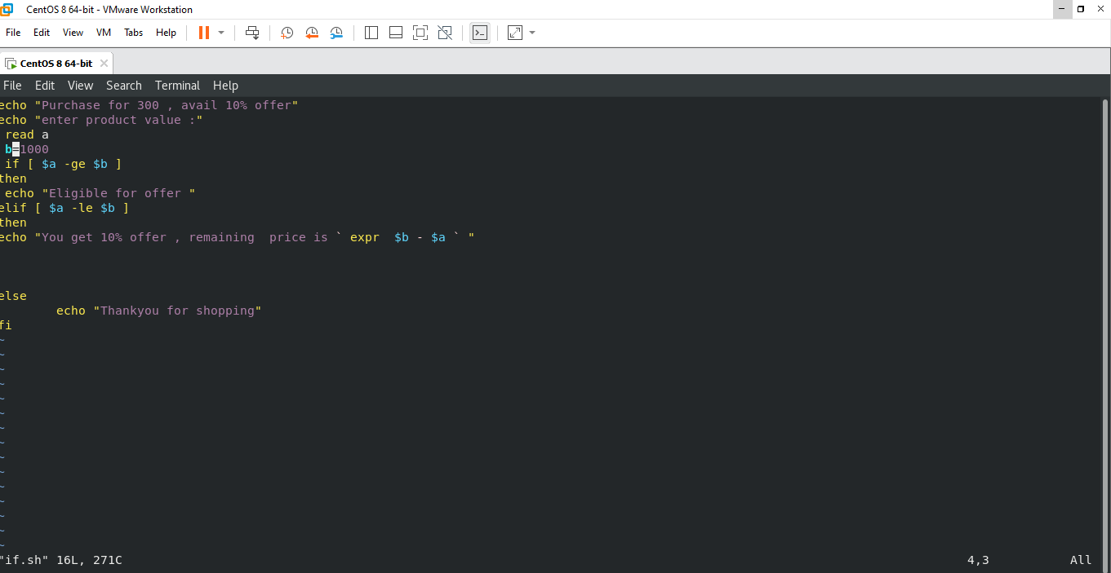
Shell Decision Making
If ..elif..else..fi

Slide 5
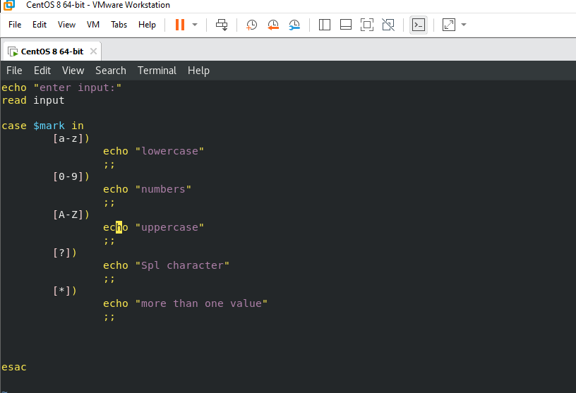
case-esac:

Slide 6
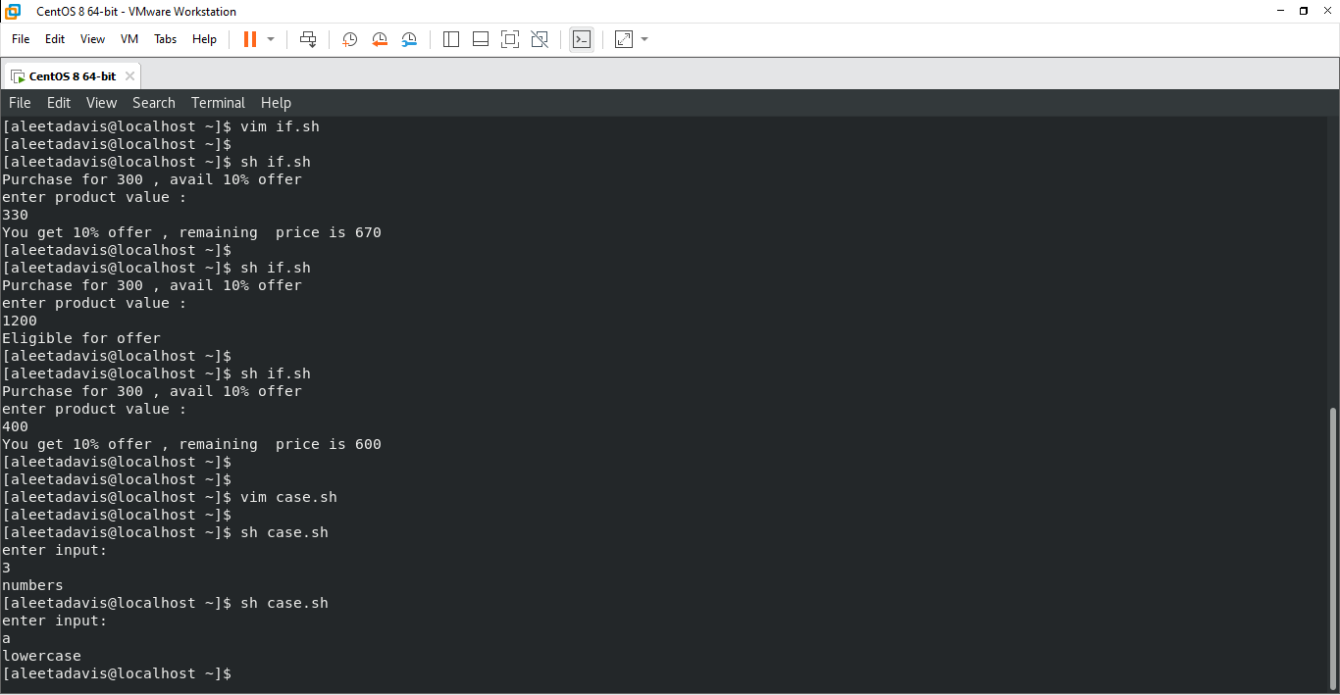

Slide 7
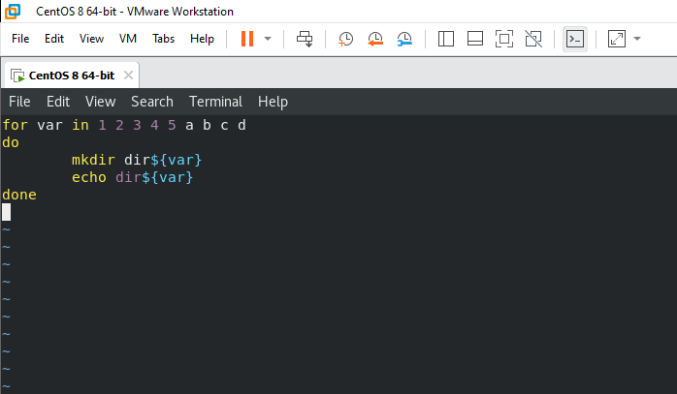
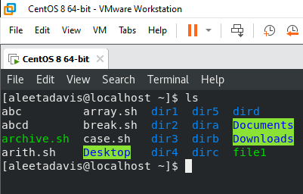
For loop:

Slide 8
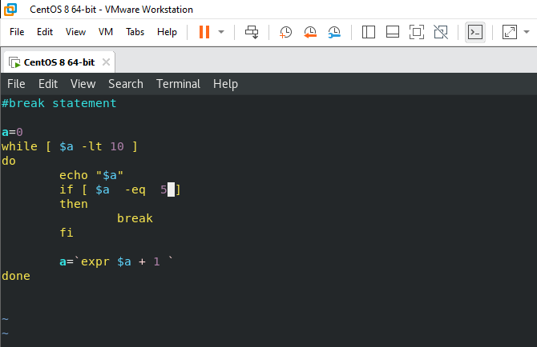
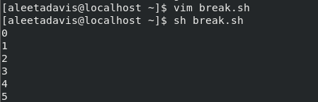
Break and while loop

Slide 9
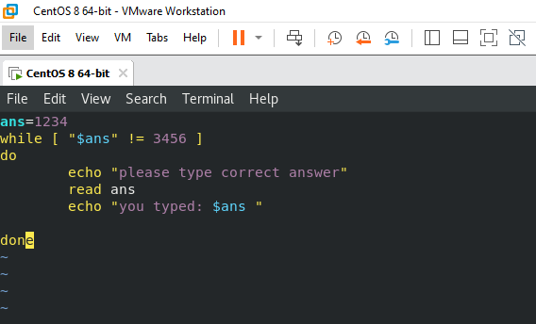
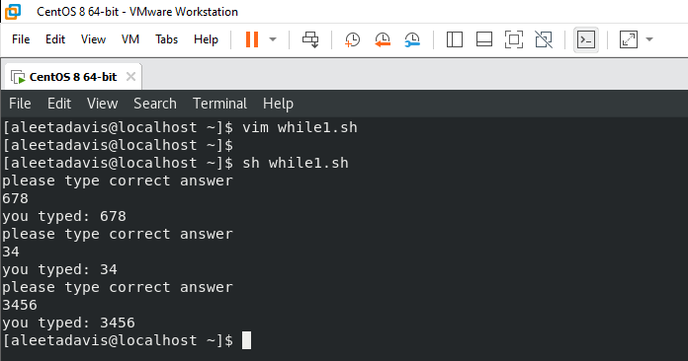
While :

Slide 10
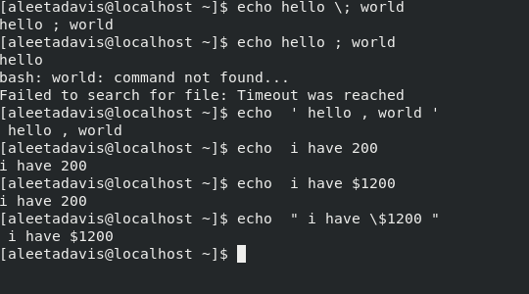
Shell Quoting Mechanism
Single quote : all special characters lose their special meaning
Double quote and backslash : * *\$ *\’ *\” *\\
Backquote : `expr $a + $b `

Slide 11
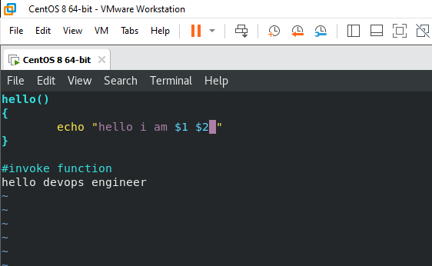
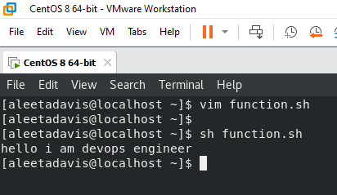
Shell Functions
Function used in shell to write reusable code.

Slide 12
Thankyou

